Slide 1

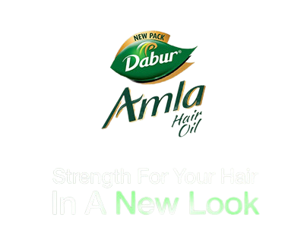
MARKET RESEARCH
Dabur Amla Hair Oil
"Asli Amla Dabur Amla"

Slide 2
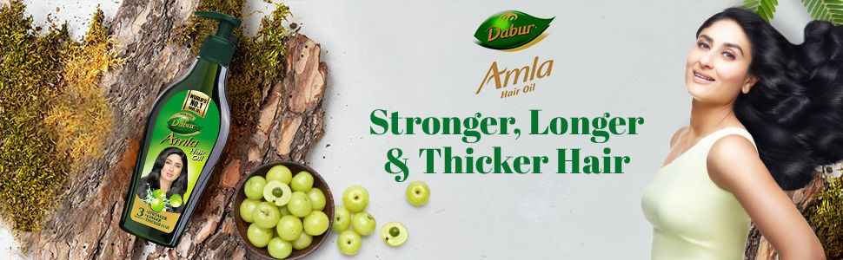
AGENDA
Background & Objectives
Research Design
Incidence Of
Hair Oil
Usage & Buying Behaviour
Brand Health Report
Conclusion

Slide 3

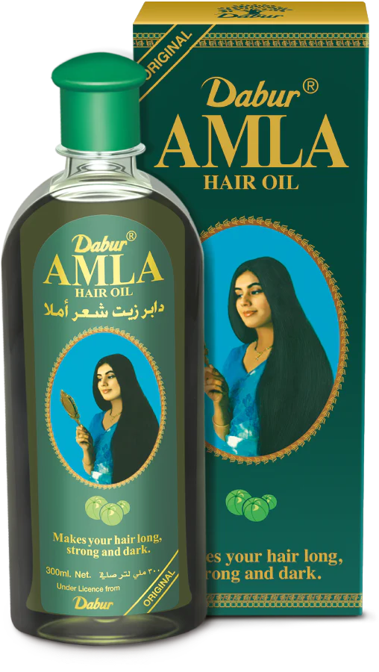
BACKGROUND & OBJECTIVES
Background :
The Indian hair oil market is valued at USD 1,536.6 million in 2023 and is expected to witness a CAGR of 5.80% over the next five years
Dabur Amla is very old brand of amla oil sub category trusted by mothers for their family's haircare
It used to be one of largest brands during 2010's but now, it's just a shadow of its former self
Product life cycle for hair oil has reached late growth stage
Objectives :
To study the incidence of hair oil as a product category
To understand its usage and buying behavior
Analyze the brand health of Dabur Amla hair oil

Slide 4
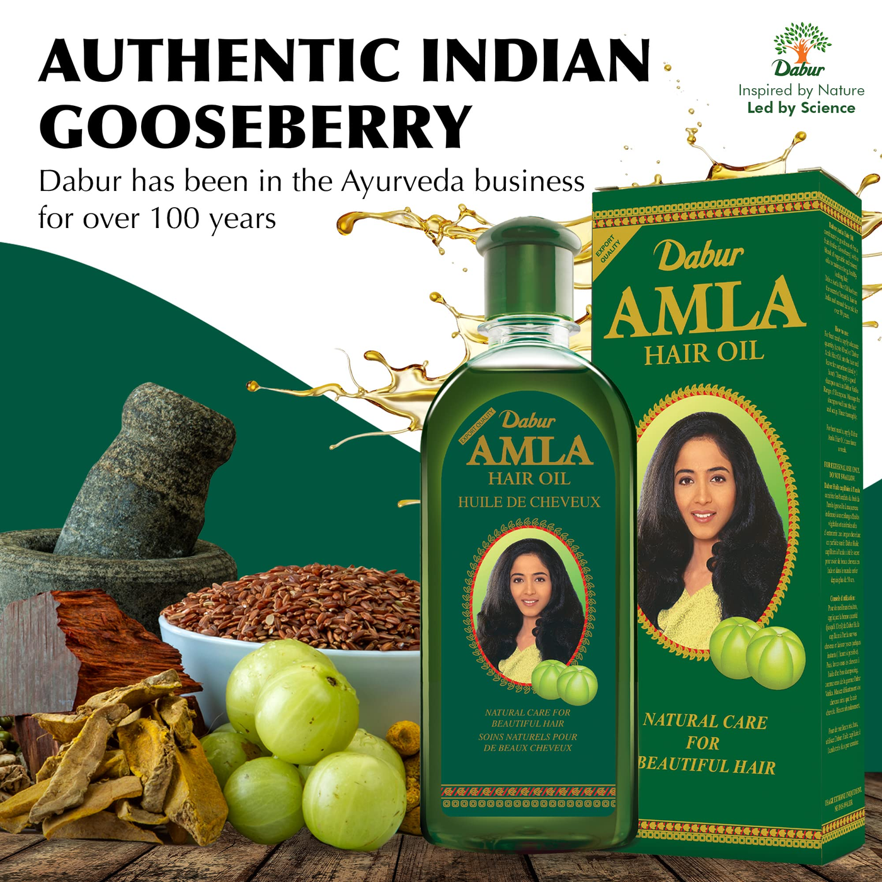
Research Design
Research Type -
Quantitative Research
Cross-sectional Research
Target Group -
Youth & middle aged men and women (15-55 Yrs)
Sampling Technique-
Convinience Sampling
Snowball Sampling
Sample Size - 391
Standard error : 5% , at 95% confidence level
SE = Z × √[{p × (1 - p)} / n
SE = 1.96 × √{( 0.5 × 0.5) / 391}
SE = 0.05 or 5%]

Slide 5

Incidence
Entire Sample : 85.93%
Male : 81.31%
Gender
Female : 91.09%
Age
15-25yr : 85.02%
25-35yr : 88.64%
35-45yr : 95.45%
45-55yr : 71.43%
55+yr : 50%
Location
Rest of WB : 85.98%
Rest of India : 91.03%
Kolkata : 83.98%

Slide 6


Usage & Purchase Behavior Statistics
Usage Frequency For Entire Sample
Purchase Behavior For Entire Sample

Slide 7
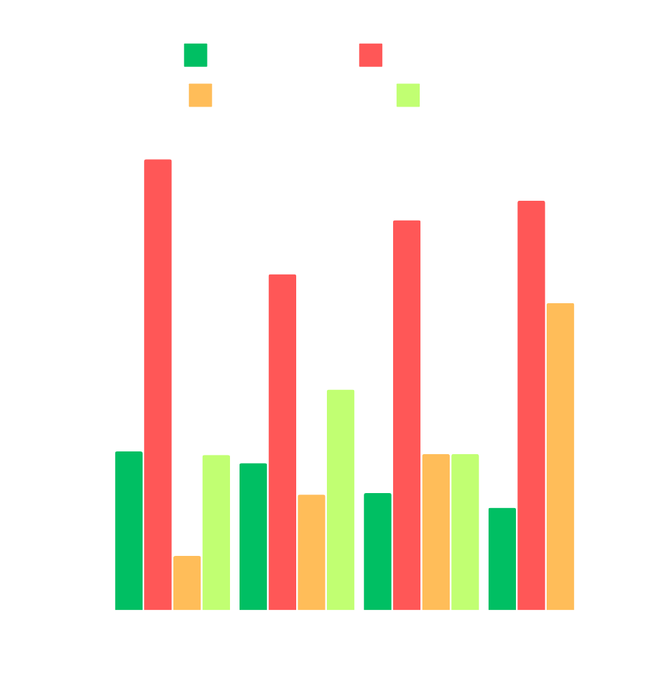
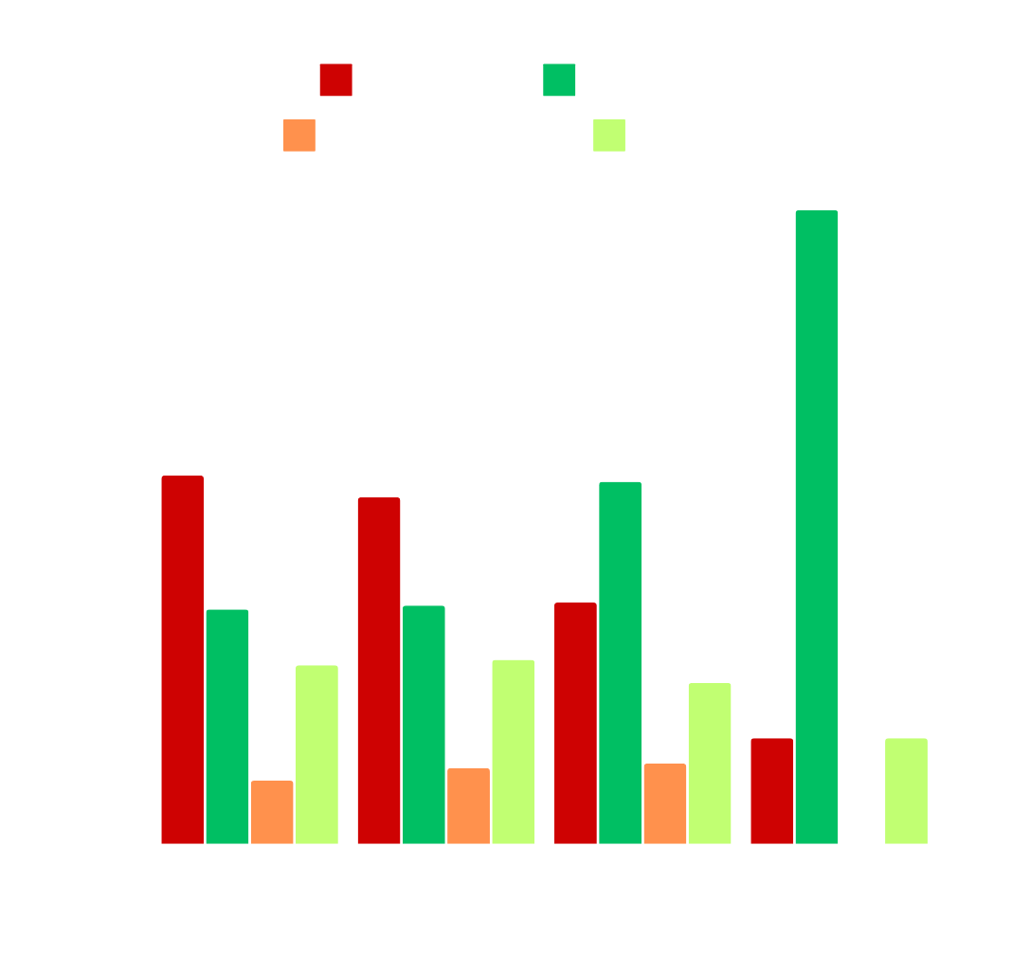
Age Group Wise Usage & Purchase Behavior

Slide 8


Gender Wise Usage & Purchase Behavior

Slide 9


Location Wise Usage & Purchase behavior

Slide 10



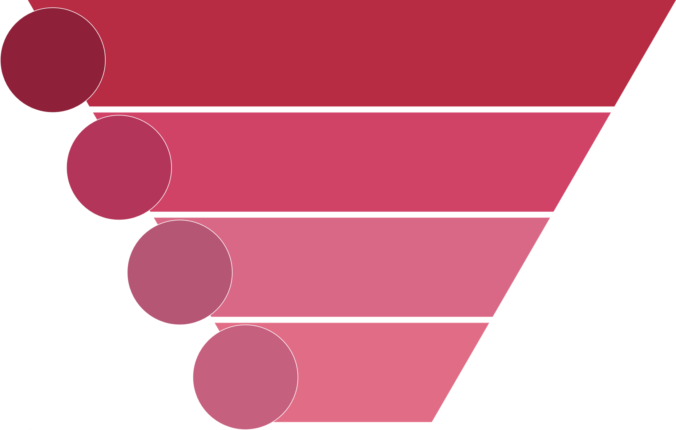
Brand Health
Dabur Amla
Parachute
Bajaj Almonds
TOM - 8.33%
TOM - 25%
TOM - 14.29%
Total Awareness-66.07%
Total Awareness-73%
Total Awareness-
72.92%
0.54
Trial- 35.71%
0.79
Trial- 57.40%
0.79
Trial- 58.33%
0.41
Repeat-14.58%
0.65
Repeat-37.20%
0.51
Repeat-29.46%
0.59
MOUB-8.63%
0.84
MOUB-31.10%
0.68
MOUB-19.94%

Slide 11
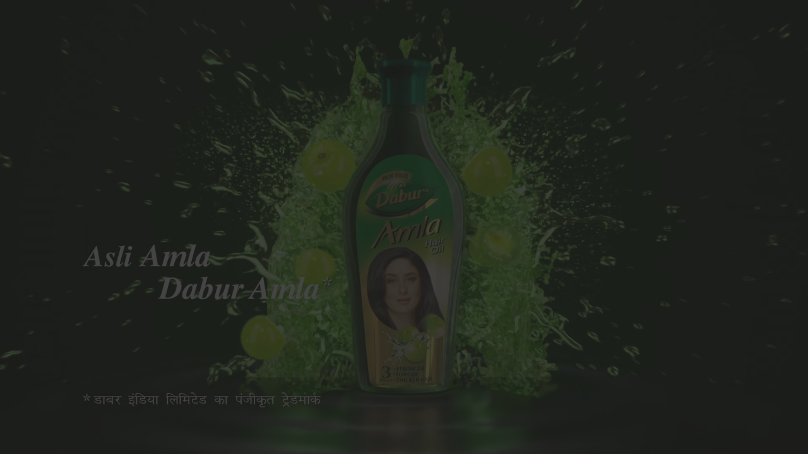
Brand Loyalty
Average User / Customer Satisfaction Score Is 4.1
Buy Different Brand
Buy From Different Shop
Wait Out
Can't Say
Most of the Dabur Amla customers are brand loyal and will buy from another shop if Dabur Amla is not available at the store they usually buy from
There are comparatively less people who will buy another brand if Dabur Amla is unavailable at the store they usually buy from
The main reason to switch to a new brand is product quality
There are few people who will wait for Dabur Amla to get restocked at the store they usually buy from and very few who are undecided
-
+
+
Parachute
Bajaj Almonds
-
++
+
++
-
--
Dabur Amla
Better Price | Better Quality | Better Availability | Better Packaging | Better Scent
13.79% | 62.07% | 10.34% | 6.90% | 6.90%
Reasons to switch :

Slide 12
Brand Image Analysis
Intended Brand Image: Trusted Natural Hair Oil Brand
Dabur
Parachute
Bajaj
People perceive Dabur Amla Hair Oil to be natural due to its ingredients but Parachute is leading in this parameter
Dabur is doing fairly well in terms of trustworthiness though Bajaj rates slightly higher in this parameter
Dabur is doing slightly worse in terms of affordability and premiumness
+
Affordability
+
++
--
Natural
-
+
Trustworthy
-
++
Premiumness

Slide 13
Brand Positioning
Dabur
Parachute
Bajaj
Intended Brand Positioning: "Zyada Lambe, Zyada Mazboot, Zyada Khubsoorat Baal"
+
Strengthens Hair
Gives Volumnous Hair
-
+
People perceive Dabur Amla Hair Oil strengthens their hair and is leading in this parameter
People don't think Dabur Amla adds volume to their hair, while Bajaj Almonds is leading in this parameter
Dabur Amla is doing average or slightly worse in all other parameters
Makes Hair Silky & Shiny
++
--
--
++
Reduces Hair Fall
Stimulates Hair Growth
Pleasant Scent

Slide 14

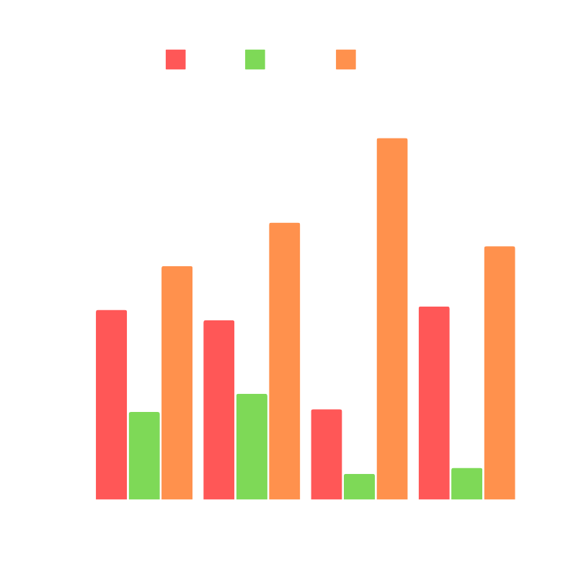
Brand Metrics
Brand Share among age groups
Brand share among income groups
Dabur Amla has relatively more market share in the age groups of 25-35 years and 45-60 years as compared to 15-25 years which has more regular users in comparison to the other age groups.
Dabur Amla's market share drastically drops among high income groups in comparison to thw low income groups. This can be linked with Dabur Amla being not perceived as a premium brand.

Slide 15


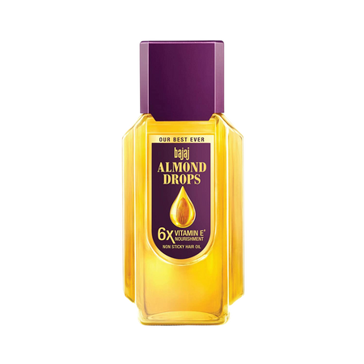
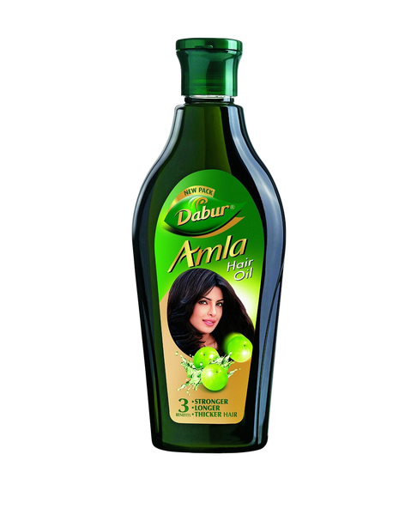
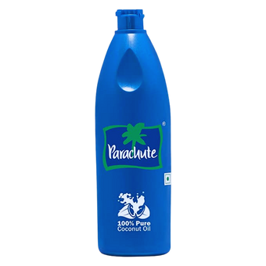
Contribution of different
income groups to Dabur
Most Often Used Brand
Regular Users vs. All Users
Regular Users : Usage Frequency - 5-6 times in a week
All Users : Users of all usage frequencies
Continuing from the last graph, the contribution to Dabur's market share is more than 85% by the low income groups.
Dabur's MOUB share amongst regular users is more than it's MOUB share amongst all users. It is vice versa for Bajaj Almonds and Parachute.

Slide 16


Contribution of diff. Locations to Dabur's MOUB
Contribution of diff. Age groups to Dabur's MOUB
15-25 years age group contributes more than the other age groups combined in the MOUB of Dabur Amla. So there could difference in brand preference amongst age groups.
Maximum contribution to MOUB of dabur comes from Kolkata.

Slide 17
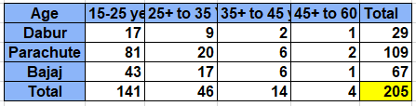
Checking whether brand preference depends on Age Group
55
H0: There is no association between age and brand preference
H1: There is signifiacnt association between age and brand preference
The chi-square statistic is 4.2876 The p-value is 0.637823. The result is not significant at p < 0.05
Chi Square Test
Result: We have to accept the null hypothesis
Conclusion : Brand preference does not depend on age.

Slide 18
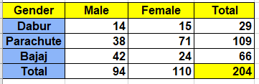
Checking whether brand preference depends on gender
H0: There is no association between gender and brand preference
H1: There is signifiacnt association between gender and brand preference
The chi-square statistic is 13.7642
The p-value is 0.001026. The result is significant at p < 0.05
Chi Square Test
Result: We can't accept the null hypothesis. The alternate hypothesis stands
Conclusion: Brand preference depends on gender significantly. It is most obviuos for Parachute and Bajaj but no such difference can be observed for Dabur.

Slide 19
Conclusion
Hair oil category incidence is quite high, even amongst the relevant sub groups
Maximum users are under the frequent user (1-2 times a week) category and mostly buy from kirana stores followed by departmental stores
While Dabur's total awareness is still comparable to the other brands but trials are drastically low and subsequently the conversion rate of trials to regular users is also very low compared to the other brands
But the regular users of Dabur Amla are mostly brand loyal though product quality is the main customer painpoint
The study further confirms the brand's intended image to be natural and brand positioning of strengthening hair
Dabur's market share amongst the regular users is more compared to its market share amongst all users
There is significant association among brand preference and gender though it can't be observed amongst regular users of Dabur

Slide 20
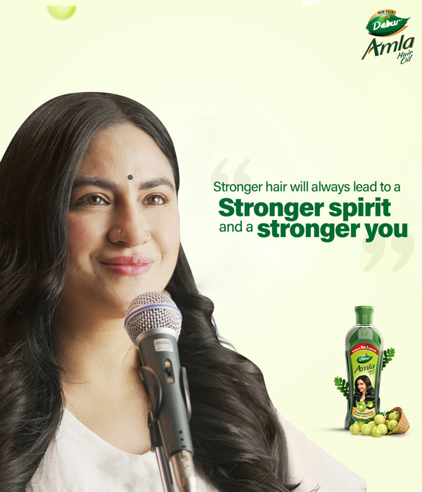

Here is the link to the questionnaire we used for our study and here is the data and workings.

